Slide 1
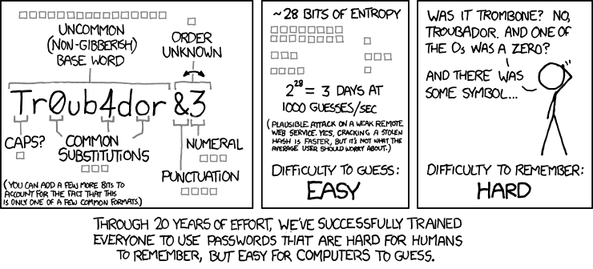
Password is Dead – A Survey of Attacks
Source:: http://thecleartech.com/wp-content/uploads/XKCD-password_strength-part1.png
Notes:
Introduction:
My name is…
Anyone cant speak german?
Passwords are dead, but why?
One of the many reasons is depicted in this picture:
Password policies force users to create complicated passwords that are hard to remember, but easy to guess for computers!
This weakness, described as Password guessability, and many other weaknesses and attacks I will present in the following slides.

Slide 2
Agenda
1. Introduction
2. Weaknesses and attacks
2.1 Client-based attacks
2.2 Transport-based attacks
2.3 Server-based attacks
2.4 Human-based attacks
2.5 Attacks on password management
3. Related password technologies
4. Conclusion

Slide 3
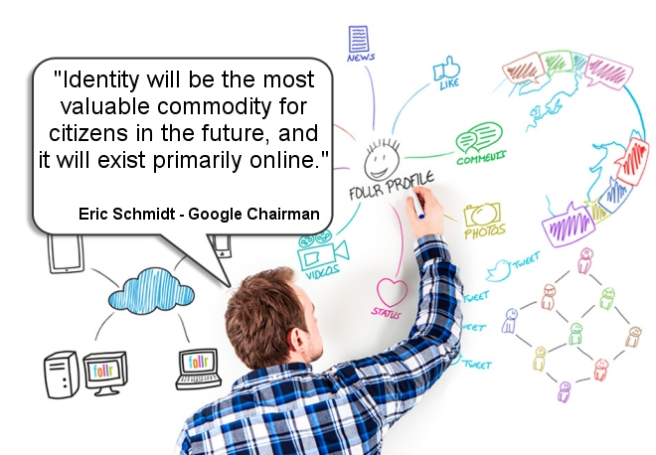
1. Introduction
Passwords (mis)used to access whole digital identity
Source:: http://pmaxquinn.net/wp-content/uploads/2015/02/Eric-Schmidt-Digital-Identity-Quote.jpg
Notes:
Passwords were designed in the 1960s to regulate access to files on large, shared mainframe computers
Originally not much personal data was accessible
Now: Passwords can access almost any personal data, that form your digital identity!
Order tickets, clothing, library, …
Cloud accounts full of personal data (photos, music, movies,…)
Online banking
Digital identity is information used to represent entities in information systems. Those entities may be persons, organisations, machines, or more abstract resources such as software processes.
The term digital identity has three distinct senses: social, legal, and computational
Together with Internet of things → digital/virtual and reallife separation becomes fuzzy
→ doesn’t scale

Slide 4
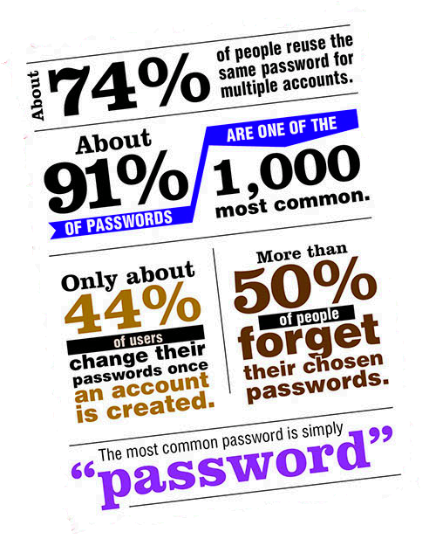
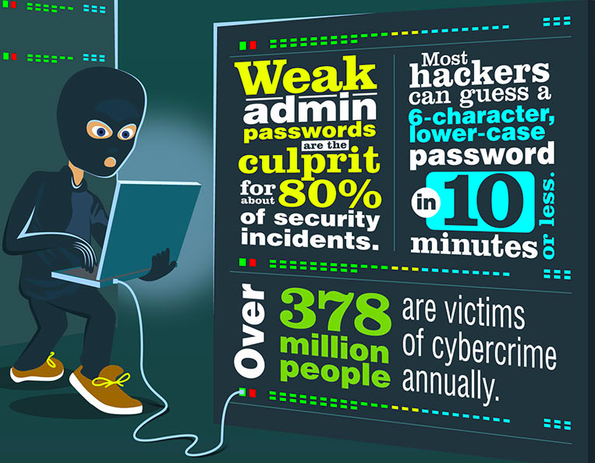
1. Introduction
Password’s are insecure from the start and easily hacked
Source:: https://i.imgur.com/ak0sIib.jpg
Notes:
Some alarming statistics from 2014 from: CNN, TheVerge, Apple.com etc.
91% of Passwords are one of the 1000 most common PWs
74% of people reuse the same PW for multiple accounts
Only 44% change their PW once created
More than 50% forget their passwords
“password” and “123456” most common PW
80% of security incidents caused by weak admin PWs
6 char PW guessable in under 10 Minutes
> 378 million people victims of cyber crime

Slide 5
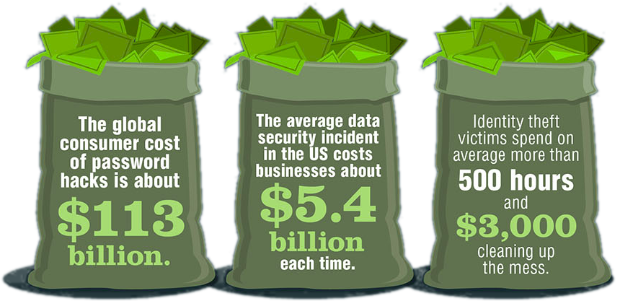
1. Introduction
Password breaches are very expensive
Source:: https://i.imgur.com/ak0sIib.jpg
Notes:
Big breaches led to services like: https://haveibeenpwned.com/ where you can search if your Email got owned (from 184 Million owned accounts so far)

Slide 6
1. Introduction
Aspects of authentication systems
Security
Privacy
!
Usability

Slide 7
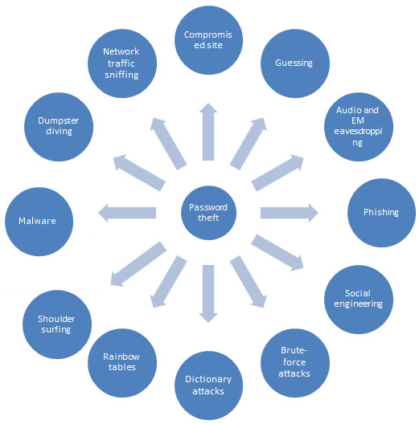
1. Introduction
Attack diversity
Source::http://2we26u4fam7n16rz3a44uhbe1bq2.wpengine.netdna-cdn.com/wp-content/uploads/figure.jpg
Notes:
- Password theft has a diversity of attacks, that’s why Im aiming to present you now my survey of attacks

Slide 8
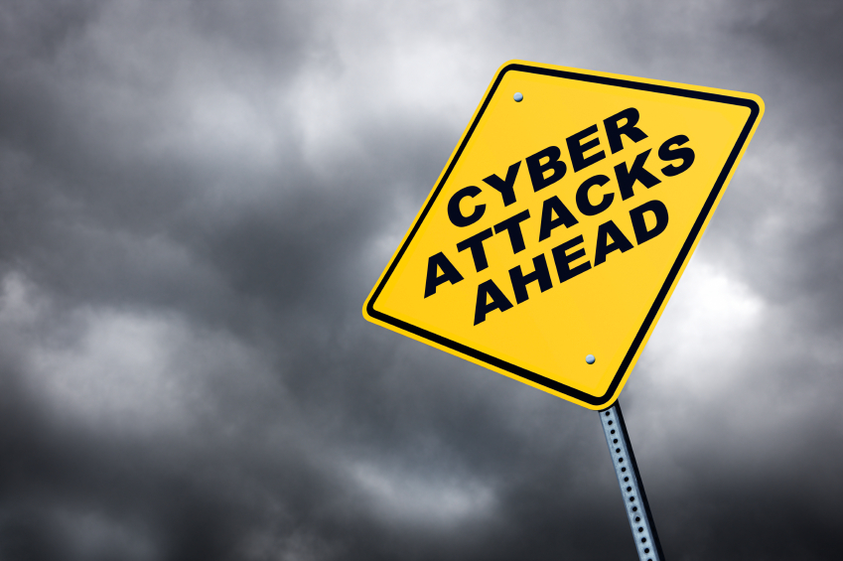
2. Weaknesses & Attacks
2.1 Client-based attacks
2.2 Transport-based attacks
2.3 Server-based attacks
2.4 Human-based attacks
2.5 Attacks based on password management
Source:: http://blog.dotcom-monitor.com/wp-content/uploads/2012/10/Cyber-Attacks-Ahead.jpg
Notes:
- Weaknesses and attacks classified by 5 authentication perspectives

Slide 9
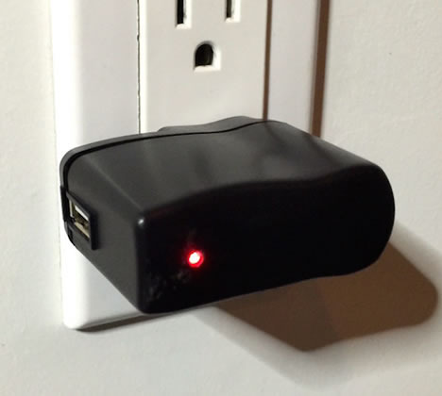
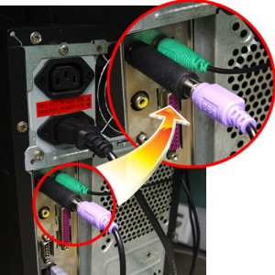
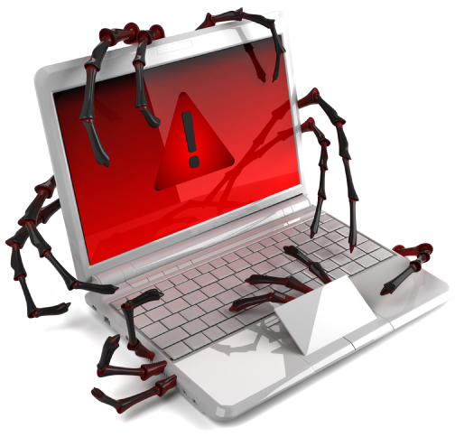
2.1 Client-based attacks
Malware
Keylogger
SW-based:
Hooks, WinAPI, Kernel
HW-based:
Interceptor (KeySweeper)
Trojan horses
Features to search passwords (Logon, Browser, Email, Messenger,…)
Man-In-The-Browser keystroke logging, Form Grabbing (ZeuS)
Source::
https://goo.gl/YWTNpL
https://:goo.gl/yIf1zO
https://goo.gl/PfQhUW
Source:: http://goo.gl/yIf1zO
Source::
http://goo.gl/yIf1zO
http://goo.gl/PfQhUW
https://goo.gl/YWTNpL
Notes:
Keylogger and Trojans are special kinds of malware, often with main purpose of stealing passwords
Keylogger:
Easiest kind of Malware to spy on keystrokes and thereby steal passwords
http://resources.infosecinstitute.com/keyloggers-how-they-work-and-more/
Many tutorials building keyloggers (SW and HW)
Hooks-based, WinAPI based, Kernel-based or HW based
January 2015: KeySweeper – HW keylogger for wireless Microsoft keyboards as stealthy USB charger
Trojan Horses:
Original purpose to remote control a victims machine
Often comes with features to automatically steal stored passwords (logon, browser, email, messenger, …)
Man-In-The-Browser: Zeus https://en.wikipedia.org/wiki/Zeus_(malware) banking trojan

Slide 10
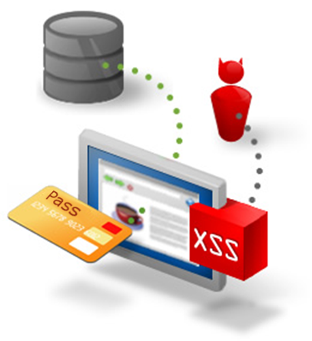
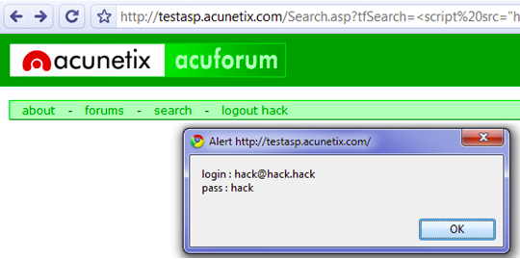
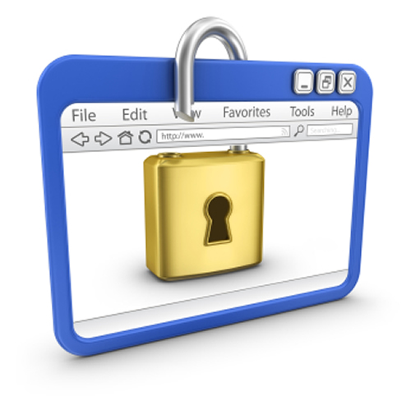
2.1 Client-based attacks
Web and browser attacks
Compromised websites (XSS)
Form grabbing
Malicious browser extensions
Zombie Browser Pack
Source::
http://www.eukhost.com/blog/wp-content/uploads/2014/07/browser-plugin-security.jpg
http://oi48.tinypic.com/nprmt3.jpg
https://lh5.ggpht.com/_MIqc395dv38/Sn8L1wAmmPI/AAAAAAAAAU0/GPllCeNZzNI/s1600-h/chromexss%5B3%5D.png
Source:: http://goo.gl/yIf1zO
Source::
http://goo.gl/yIf1zO
http://goo.gl/PfQhUW
https://goo.gl/YWTNpL
Notes:
XSS:
http://www.martani.net/2009/08/xss-steal-passwords-using-javascript.html
Form grabbing in background of autofilled (saved) password field
Browser Plugins
http://blog.trendmicro.com/trendlabs-security-intelligence/an-in-depth-look-into-malicious-browser-extensions/
https://github.com/Z6543/ZombieBrowserPack

Slide 11
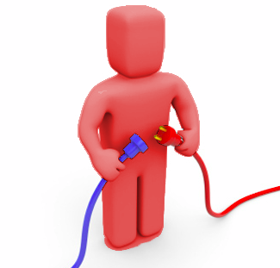
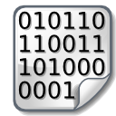

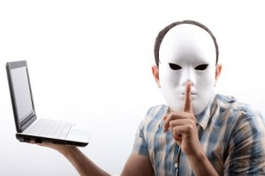
2.2 Transport-based attacks
Online attack or offline attack
Real-time MITM attacks (TLS stripping)
Offline attacks on network dump
Eavesdropping
MITM attacks: Wire-Tapping, Network sniffing (Wireshark)
Impersonation attacks
IP/MAC Spoofing (Cain & Abel)
Replay attacks
Session hijacking (zANTI)
PW
Source::
http://www.e-authentication.gov.hk/images/pic/332_1.jpg
http://blogs.lawyers.com/wp-content/uploads/2012/02/impersonate-masked-man-computer-300x199.jpg
http://www.miami.com/sites/migration.miami.com/files/images/Get-Connected-24.jpg
Notes:
Transport based attacks to steal passwords are less likely
Impersonation:
Not an attack on passwords, but on authentication systems
IP Spoofing:
MAC Spoofing/ARP Poisoning
Session Hijacking:
Very easy with Mobile Phone and zANTI Pentesterapp

Slide 12
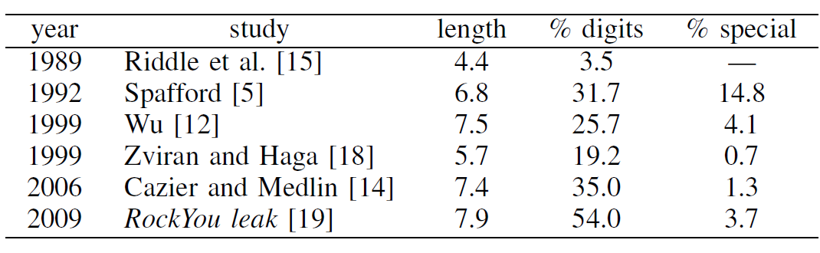
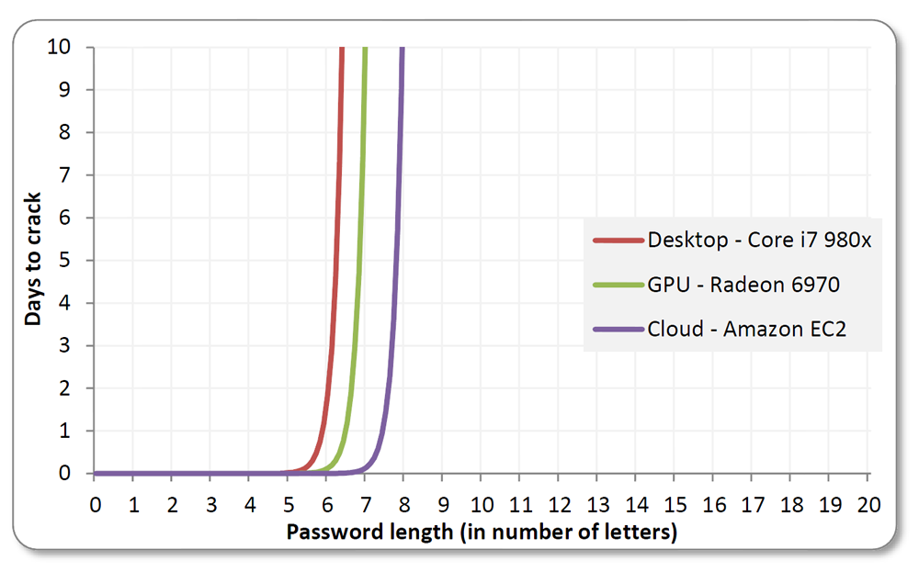
2.3 Server-based attacks
Bruteforcing
Attacker tries all combinations of possible characters
100% success rate
BUT: Exponential complexity
Password length
BUT: Entropy stays the same
BUT: CPU speed 2x all 2 years
Password Crackability
Source::
Joseph Bonneau: The science of guessing
http://www.wired.co.uk/news/archive/2013-05/28/password-cracking/viewall
Notes:
Online attack or offline attack
Offline attacks on server-side stored passwords
Online attack on authentication interfaces
Realword Password Statistics
Password statistics from 2006: https://www.schneier.com/blog/archives/2006/12/realworld_passw.html
Password statistics from 2011: http://www.codelord.net/2011/06/18/statistics-of-62k-passwords/
Password statistics from 2014: http://resources.infosecinstitute.com/beyond-password-length-complexity/

Slide 13
Password Length
Char. Space | 6 | 7 | 8 | 9 | 10 | 11 | 12
10 [0-9] | 1 ms | 10 ms | 100 ms | 1 s | 10 s | 2 m | 17 m
26 [a-z] | <1 s | 8 s | 4 m | 2 h | 2 d | 42 d | 3 y
52 [A-Z;a-z] | 20 s | 17 m | 15 h | 33 d | 5 y | 238 y | 12.4k y
62 [A-Z;a-z;0-9] | 58 s | 1 h | 3 d | 159 d | 27 y | 1.6k y | 102k y
92 (+symbols) | 13 m | 21 h | 84 d | 22 y | 2.1k y | 202k y | 19m y

Slide 14
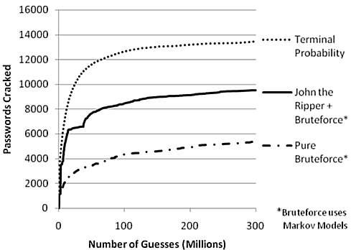
2.3 Server-based attacks
Dictionary Attacks
Subset of bruteforce attack
Success depends on dictionary
Context-specific dictionaries
Country/Language specific
Webservice specific
Victim specific
Dictionary generation:
Mangling rules
Character-by-Character Markov chain process
Weir et al.: PCFG (Probabilistic Context Free Grammar) technique
Source:: Weir et al: Password Cracking Using Probabilistic Context-Free Grammars
Notes:
Realword Password Statistics
Password statistics from 2006: https://www.schneier.com/blog/archives/2006/12/realworld_passw.html
Password statistics from 2011: http://www.codelord.net/2011/06/18/statistics-of-62k-passwords/
Password statistics from 2014: http://resources.infosecinstitute.com/beyond-password-length-complexity/
Cracker from Weir: http://www.cs.bham.ac.uk/internal/courses/isecsem/files/Whandout.pdf
Trained on password corpus to generate a dictionary with a highly
Weir performance analysis: http://www.cs.bham.ac.uk/internal/courses/isecsem/files/Whandout.pdf
2009, State of the art most performant cracking method (comparation left pucture)
Takes training data, breaks it into structures e.g. {7 letters}{1 digit}
Considers probability of structure and component strings of characters
Can be converted into lookup table/dictionary

Slide 15
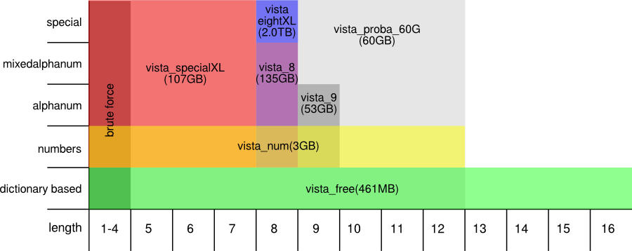
2.3 Server-based attacks
Rainbow/Lookup Tables
Offline attack only, against password hash’s
Pre-computed (reduced) lookup table
Limited only by Salt and storage constraints
Ophcrack:
NT Hash Rainbowtables:
All server-based attacks can be used hybrid and improved by using GPU and distributed cloud computation (Web Tables)
Source:: http://ophcrack.sourceforge.net/ophcrack_graph_prof.png
Notes:
Reduction Function:
Used to construct compact hash chains
N Hashes represented shorted with a start and endvalue → only N hash recomputations
Example calculation MD5:
64 possible character [A-Za-z0-9./], length 6
Text and Hash in database: each pair 16 Byte (hash(6) + Plaintext(6))
→ ~ 1 TB (64^6)*16 (10 length = 16.777.216 TB)

Slide 16
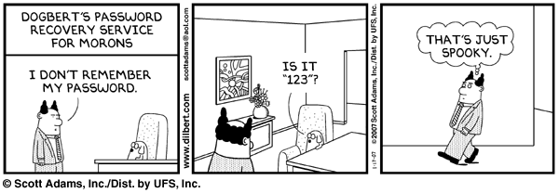
2.4 Human-based attacks
Guessability Ability to withstand guessing by a particular password cracker with particular training data, as a security metric.
Statistics based on study of up to 70 million password
Most common passwords: 123456, password, 12345678, qwerty, abc123, 111111, monkey, …
Source::
Joseph Bonneau: The science of guessing
http://blog.wcgworld.com/wp-content/uploads/2013/02/dilbert-password-recovery1.gif
Notes:
Guessability: (studies by Cranor et al. at Carnegie Mellon)
Guessability as a Password weakness is the ability to withstand guessing by a particular password cracker with particular training data, as a security metric.
Statistics to guessability based on studies by Cranor et al. (Carnegie Mellon) and Jospeh Bonneau (Stanford) (70 million passwords by bonneau and anonymized Carnegie mellon password database analysis) → Reallife passwords (compared to Amazon Mechanical Turk)

Slide 17
2.4 Human-based attacks
Guessability
Password categories
Names, Key-Pattern, Context, Hobbies, Things we like
Common substitution pattern
O, I, E, A -> 0, 1, 3, 4
S, I -> $, !
Most common symbols: !, @, #, *, .
74% reuse password for multiple accounts
Long passwords w/out symbols are stronger than short with symbols, but leads to easy guessable long passwords
Source:: Joseph Bonneau: The science of guessing
Notes:
Guessability: (studies by Cranor et al. at Carnegie Mellon)
Guessability as a Password weakness is the ability to withstand guessing by a particular password cracker with particular training data, as a security metric.
Statistics to guessability based on studies by Cranor et al. (Carnegie Mellon) and Jospeh Bonneau (Stanford) (70 million passwords by bonneau and anonymized Carnegie mellon password database analysis)
Problem: Password Reuse

Slide 18
2.4 Human-based attacks
Guessability
2014: Study of 5000 PCI-DSS compliant production passwords
86% Only 1 uppercase (mostly first)
40% Single number
20% Year (1900-2015)
90% Only 1 symbol
68% Repeated symbol
10% Password similar to username
13% Default password pattern
75% Password matches dictionary word
7% Password contains keyboard pattern
Leads to sophisticated dictionary attacks → Crackability
Source:: Jonathan Lamb: Beyond Password Length and Complexity
Notes:
http://resources.infosecinstitute.com/beyond-password-length-complexity/
Study, 2014, of 5000 production PWs compliant to PCI-DSS (Payment Card Industry Data Security Standard) policy: >7, numeric and alphanumeric characters, one upper and one lower case letter
Avg. : 9,6 (length), 1.1 (upper), 6,1 (lower), 2,2 (numbers), 0,2 (special chars)
Uppercase letter mostly the first letter and 86% the only one
Single numbers very common (41%), also years between 1900-2015 (20%)
Only 1 special character (90%), (“!” – 29% , “.” – 19% , “@” – 15% and hash “#” – 14%)
Multiply special chars: 68% only repeating the same symbol (e.g. ###)
13% adopting Default-Password-changing pattern (e.g. defPW-ebay, defPW-facebook, …)
10% use password similar to username
75% matched a dictionary entry (168,000 English language words)
Keyboard pattern: 7%
→ Polcies become extrem complex to protect against all those patterns, they have to adapt…
→ BUT usability and memoreability can’t be increased!
→ vicious cycle

Slide 19
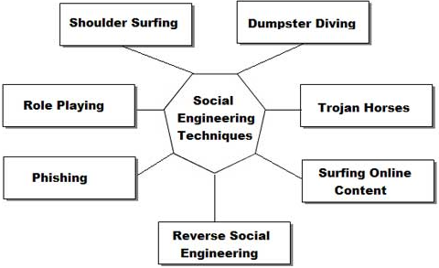
2.4 Human-based attacks
Social Engineering
Source:: http://inspiratron.org/introduction-to-social-engineering/
Notes:
Social engineering: Defined as any act that influences a person to take an action that may or may not be in their best interest
Statistics:
http://www.csoonline.com/article/2129673/social-engineering/social-engineering-attacks-costly-for-business.html
2011, 850 IT professionals: (US, Germany, Australia, …) :
48%, been victims of social engineering with 25 or more attacks in the past 2 years
http://searchsecurity.techtarget.com/feature/Social-engineering-attacks-Is-security-focused-on-the-wrong-problem
October 2013, RSA identified more than 62,000 phishing attacks

Slide 20
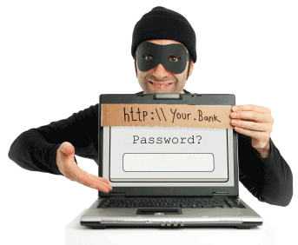
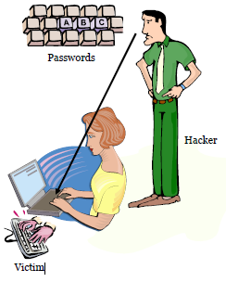
2.4 Human-based attacks
Social Engineering
Quid pro quo
Reflected XSS
Phishing
Forged emails, webservices
Fake phone calls, SMS, QR-Codes
Tab-Napping
Shoulder surfing
Monitor keyboard and lips
Heat pattern (PIN)
Source:
http://www.hacker9.com/wp-content/uploads/2008/11/how-to-create-fake-facebook-login-page.png
http://www.crazylearner.org/wp-content/uploads/2013/07/2.png
Notes:
Phishing:
Fake: Emails, Websites
Click Jacking, Tabnapping
Vishing (Phone), Smishing (SMS phishing),
QR Codes, …
Quid pro Quo (Call as IT support to bring people to install malware)
Physical Attacks:
Blackmailing
Baiting (USB drive)
Insider Attacks:
Not always focused on password theft, but hard to detect
Insider might install malware, might reveal passwords, …
Shoulder Surfing:
Monitor keyboard
Monitor lips
heat pattern of PIN keyboard

Slide 21
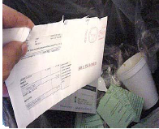
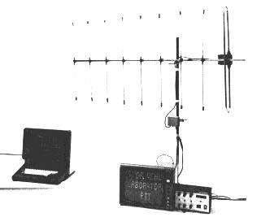
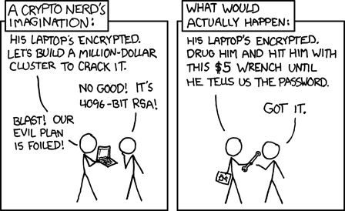
2.4 Human-based attacks
Physical attacks
Blackmailing, Threatening
Baiting (USB drive)
Dumpster diving
Tempest attack
Insider attacks
BYOD
Careless employees
No or weak insider policies
Source:
http://www.crazylearner.org/wp-content/uploads/2013/07/3.png
http://climateviewer.com/wp-content/uploads/2014/01/tempest1.png
https://sslimgs.xkcd.com/comics/security.png
Notes:
Physical Attacks:
Blackmailing
Baiting (USB drive)
Insider Attacks:
Not always focused on password theft, but hard to detect
Insider might install malware, might reveal passwords, …
https://hbr.org/2014/09/the-danger-from-within:
KPMG: Insider attacks increased between 2007-2010 from 4-20%

Slide 22
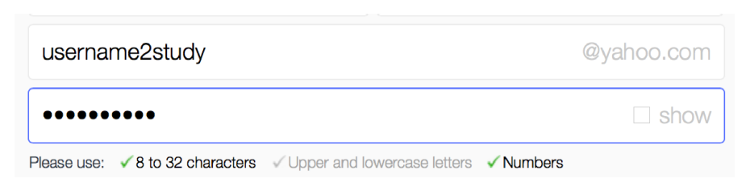
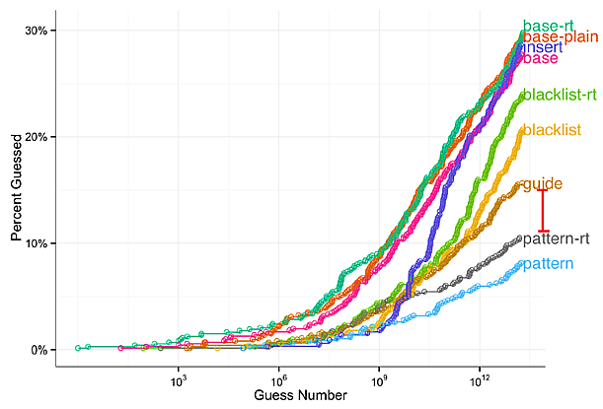
2.5 Attacks on password management
Password creation
Weak password strength meter
Multistep guided password creation
Usability and Security
But also, Guessability
Source:: Cranor et al: Spoon full of sugar
Notes:
Password creation:
Some Password meters are not strict enough
Guided password creation (Spoon full of sugar, 6,435-participant online study)
Types: Feedback, Guided, Random Insertion
Increased usability for creating policy compliant passwords, creation time, creation errors
Increased password strength
Lead to increased guessability

Slide 23
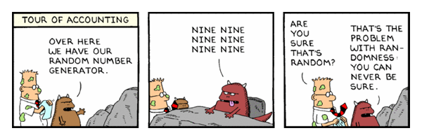
2.5 Attacks on password management
Password generation
Flawed password generation implementations
Pseudo-random number generator predictable
Not enough entropy
Password stripping (Limited character space)
Guessability
Source:: http://bits.usc.edu/wordpress/wp-content/uploads/sites/8/2014/09/aEj6S.png

Slide 24
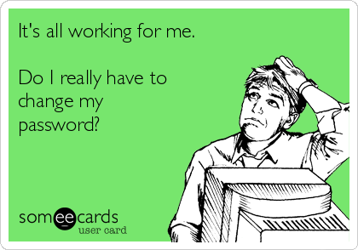
2.5 Attacks on password management
Password recovery
Often weakest point in authentication mechanisms
Security questions
If correct: Easy to guess (Phishing, Reconnaissance)
If incorrect: Lock out danger
Vulnerable password reset mechanisms
Facebook: Friend vouching
Changing many passwords frequently (Heartbleed)
Only 44% change their passwords
Usability
Source:: http://cdn.someecards.com/someecards/usercards/its-all-working-for-me-do-i-really-have-to-change-my-password-9d2d9.png
Notes:
Password recovery:
Security question: Mat honan example
Heartbleed example: Usability problem of changing all passwords
Facebook vouching:
Reset Facebook password with 3 vouching friends
http://www.rafayhackingarticles.net/2012/08/hack-facebook-account-by-exploiting.html
83 million FB accounts are fake
victim has 3 fake friends controlled by attacker → account stolen)

Slide 25
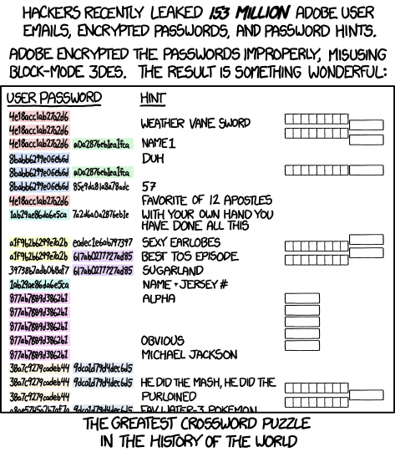
2.5 Attacks on password management
Password storage
Plaintext storage (13% write passwords down)
>50% forget their passwords
Storage weakly encrypted
Storage with password hint (Adobe breach 2013)
Storage as hash with weak hash-function (with/out salt/pepper)
Source:: https://imgs.xkcd.com/comics/encryptic.png
Notes:
Password Storage:
Plaintext storage (Cranor study: 13% write password down)
weak hash functions (cracking resistant hash functions → Rainbow Tables crack it anyway)
Many employees write passwords down on paper
Example: Adobe Breach 2013
https://nakedsecurity.sophos.com/2013/11/04/anatomy-of-a-password-disaster-adobes-giant-sized-cryptographic-blunder/
one of the largest breaches of username databases ever, with 150,000,000 records exposed
Used 3DES in ECB mode , if broken (easily done) → all passwords are broken

Slide 26
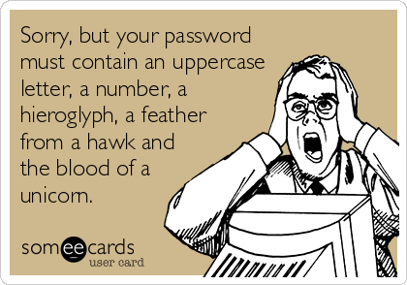
2.5 Attacks on password management
Password policies
Policy compliant passwords: Easy to guess, hard to remember/use
Guess-ability
Policy Comp-lexity
Usability Memor-ability
Source:: http://cdn.someecards.com/someecards/usercards/MjAxMy04YmMwOWYzNTU0ZTgzOTlk.png
Notes:
Weakness implications from Password Policies
Studies about guessability (Cranor, Lamb, Bonneau) showed: Password policies influence guessability and usability
→ Useability problem (e. Passwords get longer and more complicated to be more secure, hard to input on mobile phone)
http://resources.infosecinstitute.com/beyond-password-length-complexity/
Study, 2014, of 5000 production PWs compliant to PCI-DSS (Payment Card Industry Data Security Standard) policy: >7, numeric and alphanumeric characters, one upper and one lower case letter
Avg. : 9,6 (length), 1.1 (upper), 6,1 (lower), 2,2 (numbers), 0,2 (special chars)
Uppercase letter mostly the first letter and 86% the only one
Single numbers very common (41%), also years between 1900-2015 (20%)
Only 1 special character (90%), (“!” – 29% , “.” – 19% , “@” – 15% and hash “#” – 14%)
Multiply special chars: 68% only repeating the same symbol (e.g. ###)
13% adopting Default-Password-changing pattern (e.g. defPW-ebay, defPW-facebook, …)
10% use password similar to username
75% matched a dictionary entry (168,000 English language words)
Keyboard pattern: 7%
→ Polcies become extrem complex to protect against all those patterns, they have to adapt…
→ BUT usability and memoreability can’t be increased!
→ vicious cycle

Slide 27

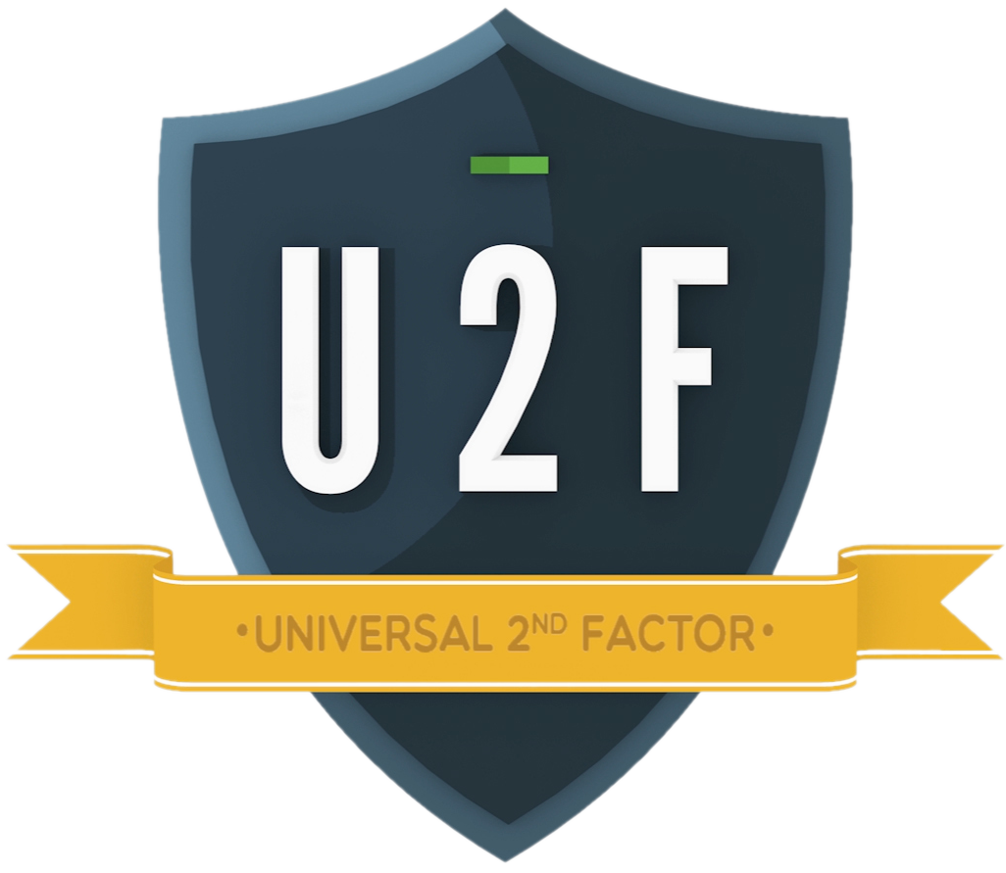
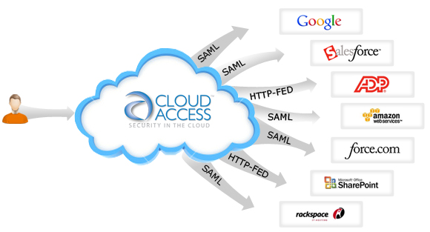
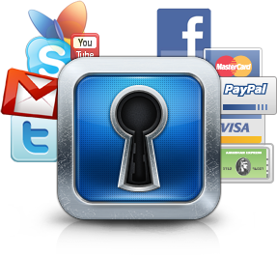
3. Related password technologies
Source::
http://www.cloudaccess.com/wp-content/uploads/2015/01/SaaS-SSO.jpg
http://checksum.biz/wp-content/uploads/2015/05/PasswordKeeper.png
https://embed-ssl.wistia.com/deliveries/4e80e7c4bbf58608bc7cb0d8184677f8d97da468.jpg
http://nordicapis.com/wp-content/uploads/OpenID-Connect.jpg

Slide 28
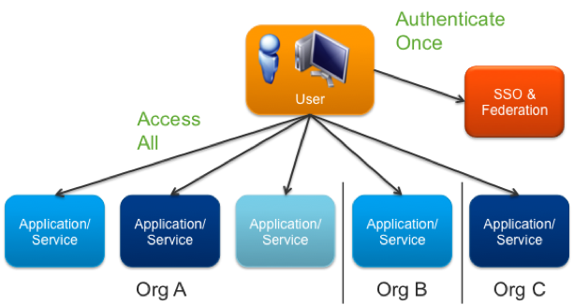
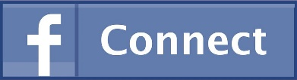
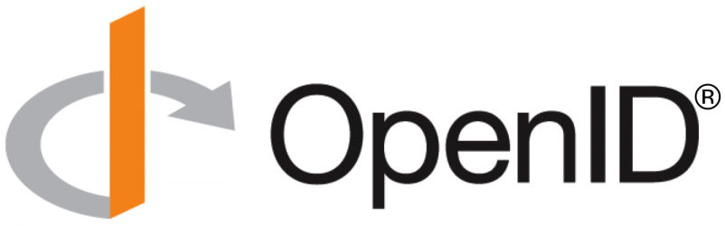
3. Related Password Technologies
Single Sign On
Federated Identity Management (SAML, OpenID)
Social Login (Facebook Connect)
Privacy
Single Point of Failure
Source::
http://www.dubitlimited.com/blog/wp-content/uploads/2013/02/FB-Connect-crop.jpg
http://openid.net/wordpress-content/uploads/2014/09/openid-r-logo-900x360.png
https://blogs.vmware.com/vfabric/files/2013/03/authentication_chart.png

Slide 29
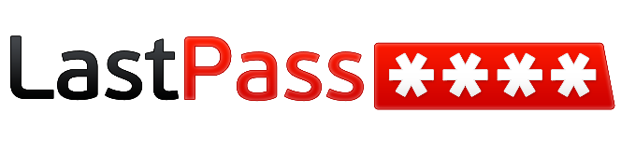

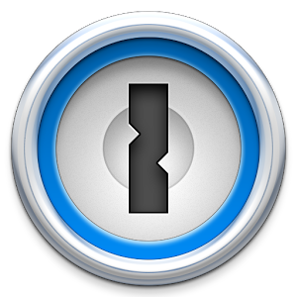

3. Related Password Technologies
Password Manager
Encrypted storage of passwords
Single master password
Local/Mobile/Cloud
Browser, LastPass, KeePass, 1Password, Dashlane …
Weak implementations
Single Point of Failure
Lock out danger
Source::
http://www.mobiflip.de/wp-content/uploads/2014/08/LastPass_Logo.png
http://blog.botfrei.de/wp-content/uploads/2012/06/keypass_logo.png
https://lh5.ggpht.com/a_fdt5QXfEG9qDsqJUrmoyDOycgnlX_vMwhUS-lglOq_XRneCrN7T0HUeeQlVlBzIFE=w300
http://screenshots.en.sftcdn.net/en/scrn/3338000/3338284/dashlane-12-535x535.png
Notes:
Silver et al.: Password Managers: Attacks and Defenses, https://crypto.stanford.edu/~dabo/pubs/abstracts/pwdmgrBrowser.html
Password Manager:
Single Point of Failure
Weak implementations
Autofill polcies → sweep attacks over rogue access point
Web/Bookmarklet flaws
User Interface flaws
Password Generator flaws
LastPass Breach 15. June 2015:
LastPass account email addresses, password reminders, server per user salts, and authentication hashes were compromised

Slide 30
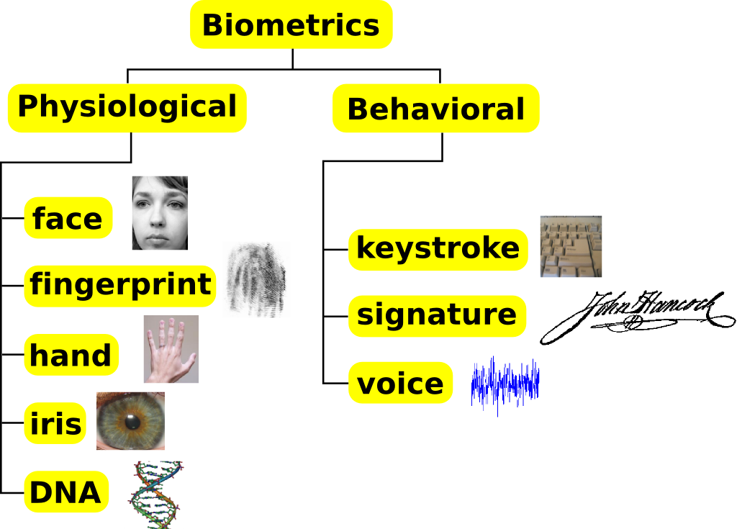
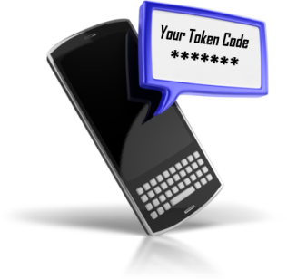
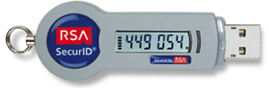
3. Related Password Technologies
Multi Factor Authentication
Biometrics
Fingerprint, Voice, Eye, …
Many false positives and negatives
Easily stolen
Revocation not possible
Privacy and Usability
Second Factor
Software/Hardware Token, Call, SMS, Email, …
Lock out danger
Usability
FIDO alliance: U2F
Source::
https://saravanesh.files.wordpress.com/2011/01/biometrics_traits_classification11.png
https://store.emc.com/medias/sys_master/images/8798055628830/RSA-SecurID-HW-Auth-IMG-02.png/
http://www.sscjo.com/products/SMS%20Token.png
Notes:
Multi Factor Authentication:
Biometrics, Second Channel, Second device, Behavior, …
FIDO alliance (Fast IDentity Online) U2F (universal second factor framework)
Usability problem
Biometrics false negatives (Fingerprint, Voice,…)
Authentication becomes a long process
Revocation/Recovery not possible

Slide 31
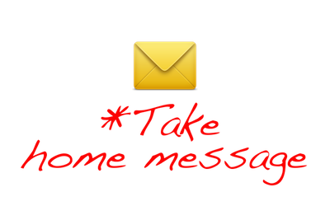
Source http://rebelem.com/wp-content/uploads/2014/04/take-home-message.png

Slide 32
4. Conclusion
Passwords: Protector of our digital identity
Single Point of Failure
Many weaknesses and countless attacks
Guessability ←→ Policy complexity ←→ Usability
Strong security → weak usability & privacy
It was never easier to steal user’s digital identity
Call for Password-less authentication systems
Digital Alter Ego:
Who we are and what we do
Where we go and when
What we have with us and how we act when we’re there
Notes:
Password guessability increases → Policy complexity increases → usability decreases → Vicious cycle → we have to get rid of password systems!!
Password less authentication:
Multi factors and not only factors based on human conscious behavior, also unconscious like eye tracking, typing behavior, etc…

Slide 33

Thanks' for your attention!
Questions?
Author: Sebastian Funke
Email: sebastian.funke.mail@gmail.com
Source:: http://www.snoringmouthpieceguide.com/wp-content/uploads/2013/11/message-300x300.jpg

Slide 34
Sources
Bonneau, Joseph: The science of guessing: Analyzing an anonymized corpus of 70 million passwords, 2012
Honan, Mat: Kill the Password: Why a String of Characters Can’t Protect Us Anymore. http://www.wired.com/2012/11/ff-mat-honan-password-hacker, 15.11.2012
Silver et al.: Password Managers: Attacks and Defenses, 2014
Cranor et al.: Measuring Password Guessability for an Entire University, 2013
Cranor et al.: The Impact of Guidance and Feedback on Password-Creation Behavior, 2015
Weir et al.: Password Cracking Using Probabilistic Context-Free Grammars, 2009
Goddin, Dan: Anatomy of a hack: even your 'complicated' password is easy to crack, http://www.wired.co.uk/news/archive/2013-05/28/password-cracking/viewall, 05.28.2013
Lampe, Jonathan: Beyond Password Length and Complexity, http://resources.infosecinstitute.com/beyond-password-length-complexity/ , 01.06.2014
Infographic: http://www.visualistan.com/2014/11/is-password-dead-infographic.html, 2014
Find more sources in the corresponding paper.

